Slide 1
Each year VENT for Change organise Share a Pencil Day to raise awareness of the millions of children around the world who are still unable to access the education they deserve…..
1.
Notes:
Good morning everyone. Today as a school we are taking part in Share a Pencil Day along with hundreds of thousands of children all across the country. The day is organised by VENT for Change. VENT is a Giving Enterprise that supports education projects around the world through the sale of pencils and other stationery.
NEXT SLIDE

Slide 2
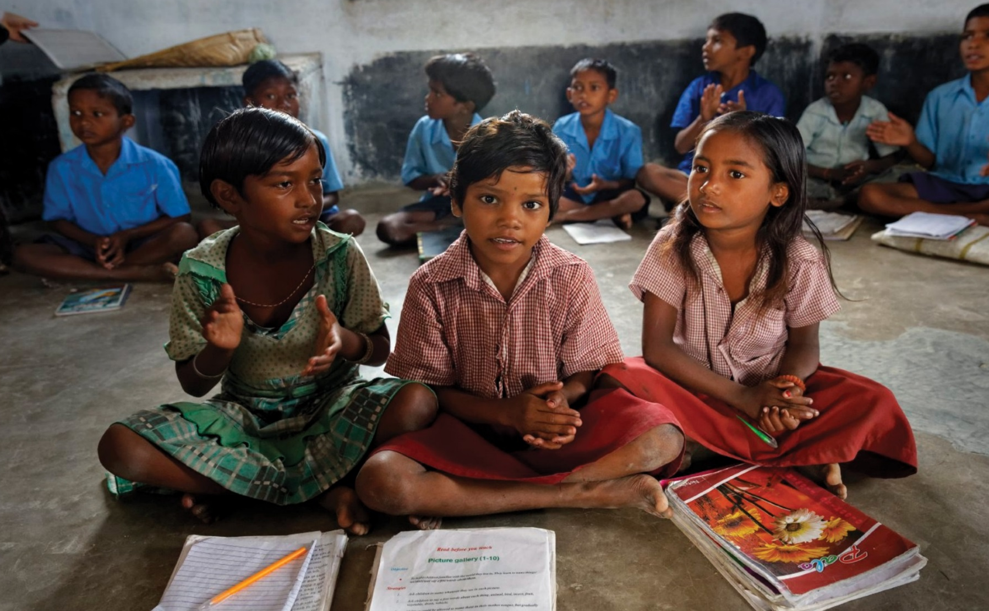
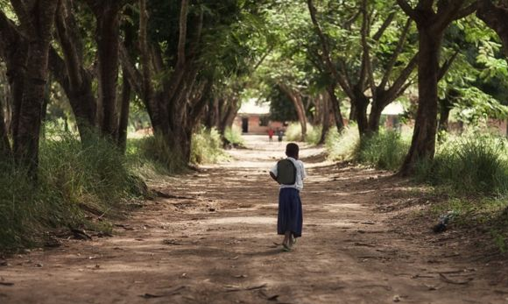
2.
Notes:
Millions of children around the world have no access to education and cannot go to school. For those that can many have to walk hours to get to school each day. Many more lack the resources they need for learning. Children have to share books, rulers, pens and pencils. Many schools do not have enough qualified teachers, many don’t have tables and chairs and children learn while seated on the floors.
Why?
NEXT SLIDE

Slide 3
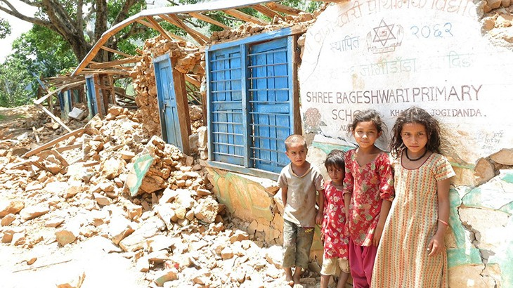
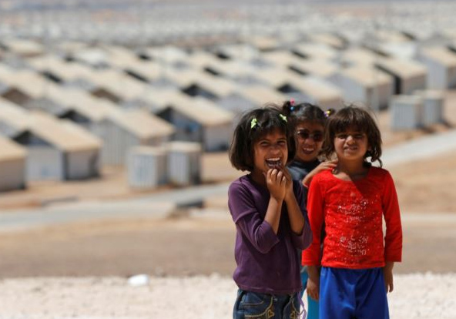
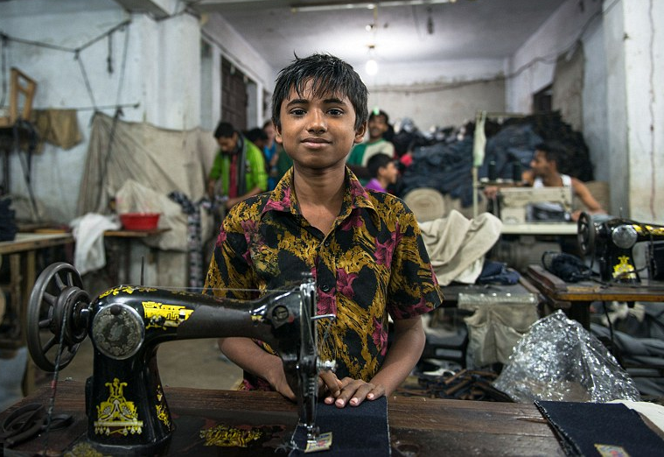
3.
Notes:
…. There are many reasons but the four most common are; war and conflict (like the crisis in Syria), Teenage Marriage, Natural disasters (like the Earthquake in Nepal) and Extreme Poverty (Children working to support families or parents who simply cannot afford the tuition fees or uniforms required to attend school). While some schools are free to attend parents often have to pay for the extras, even the those extras like notebooks, pens and pencils are simply too much for many families
NEXT SLIDE

Slide 4
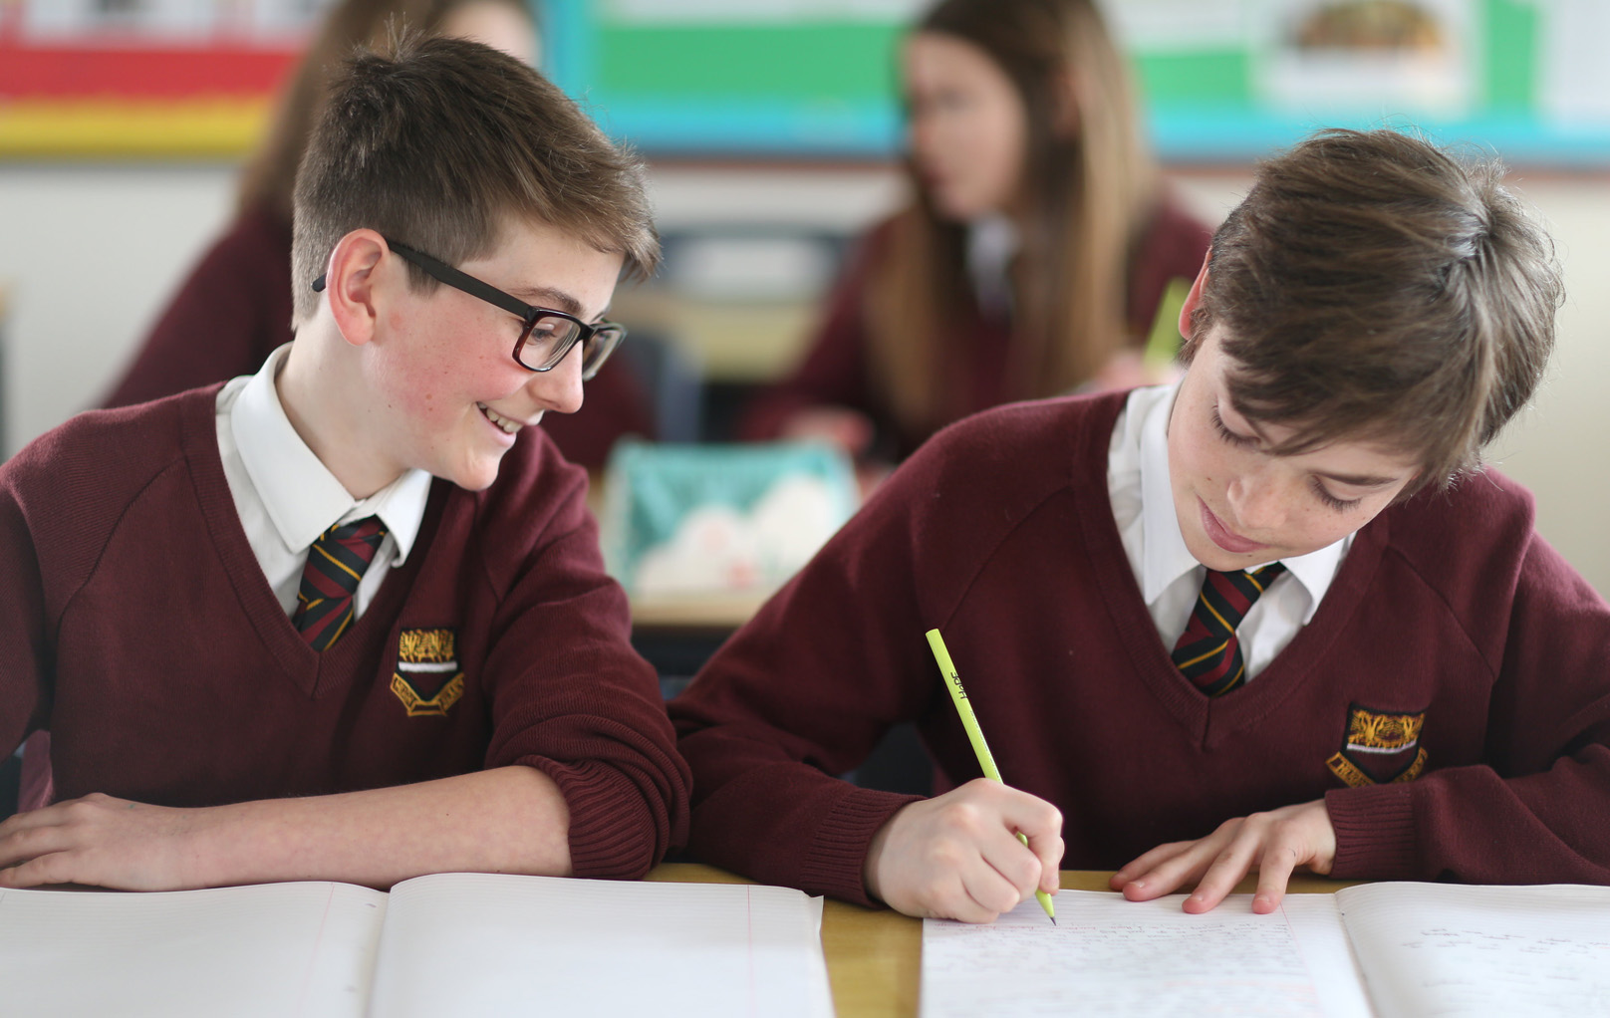
4.
Notes:
Share a Pencil Day is a day on which we can learn a little about these issues. Why children cannot get the schooling they deserve and what difference it would make if they could.
It is a day to reflect on how lucky we are to be able to go to school. Some of you may think it would be great not to go to school but think of this…..
NEXT SLIDE

Slide 5
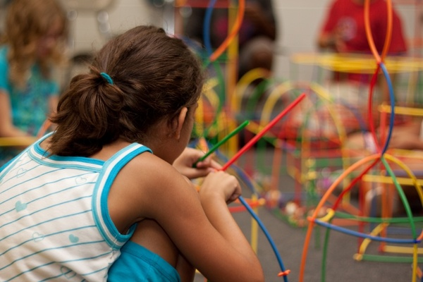
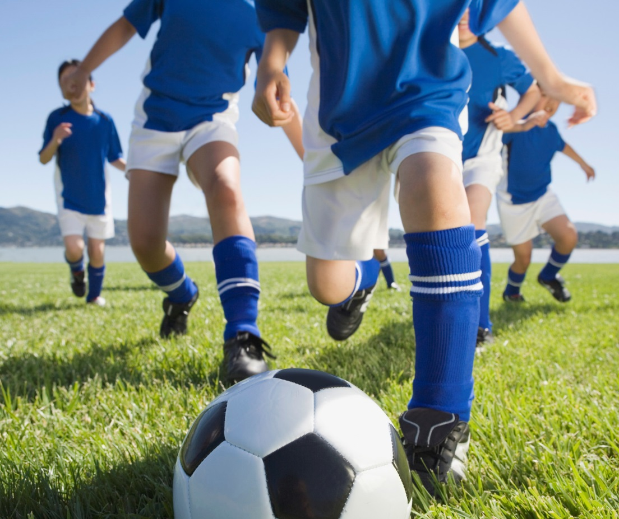
5.
Notes:
School is a chance not only to learn to read and write, to master your maths, science and languages.
School is a chance to make friends, a chance the play with one another and participate in sport, a chance to learn musical instruments as well as doing arts and craft.
School is where we learn to interact and work in groups as well as on our own. School is where we prepare for life as a grown up, choose what we want to be in life and a launch pad from which we can follow our dreams.

Slide 6
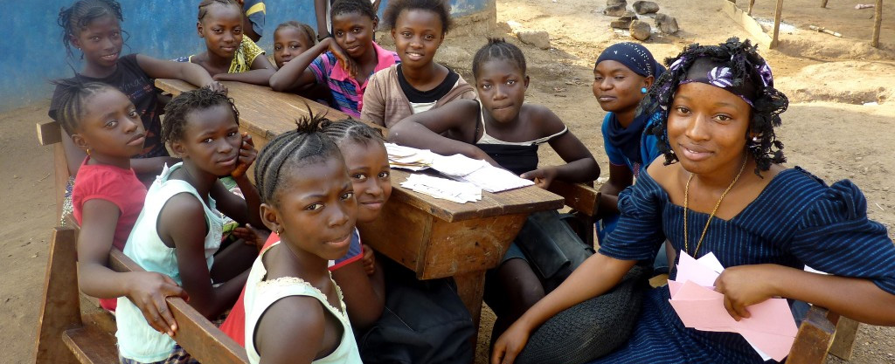
6.
Notes:
While those our your dreams children around the world dream of the chance to go to school. Those lucky enough to go sometimes have to walk for hours to get there every day. Many sacrifices are made around the world so children can access an education, we need to help but before that we need to understand the problems children face so we can do our bit
Education is the single most important thing a child can have to lift themselves and their families out of poverty.
NEXT SLIDE

Slide 7
7.
Notes:
In September 2015, 193 world leaders agreed to 17 Global Goals for Sustainable Development. If these Goals are completed, it would mean an end to, among other things, extreme poverty, inequality and climate change by 2030.
NEXT SLIDE

Slide 8
8.
Notes:
CHOOSE ONE OR OTHER
Now you are going to watch a short animated film
Global Goals, part of the worlds largest lesson in 2016, introduced by the actress Emma Watson OR
Chankra the Invincible, a cartoon that explains why children in India still cannot go to school.
CLICK ON THE IMAGE to open film in a new window. (This is a link so internet is required)

Slide 9
Goal 4. Ensuring quality education that is both inclusive and equal, to promote lifelong learning opportunities for everyone.
9.
Notes:
Share a Pencil Day is supporting Goal 4 of the Global Goals. Ensuring quality education that is both inclusive and equal, to promote lifelong learning opportunities for everyone.

Slide 10
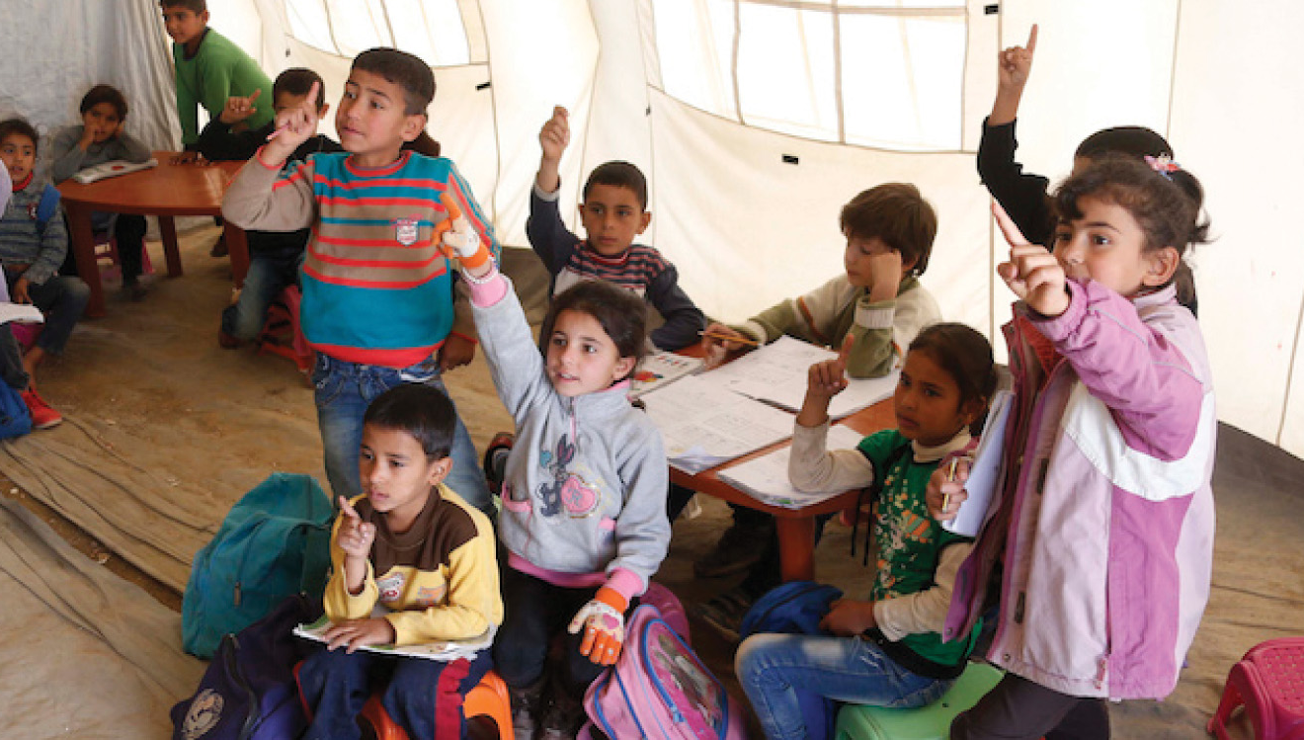
10.
Notes:
As part of Share a Pencil Day you will be taking part in a structured lesson explaining some of the reasons children cannot go to school and why that is important. You will have heard some of this in the news or TV progams you watch.
NEXT SLIDE

Slide 11
11.
Notes:
During that one lesson today you will be asked to Share one Pencil between two pupils. This is so everyone can try to understand first hand what it’s like not to have all the things in the classroom that we take for granted. Children around the world have to share every day. Just today let’s see how that feels.
NEXT SLIDE

Slide 12
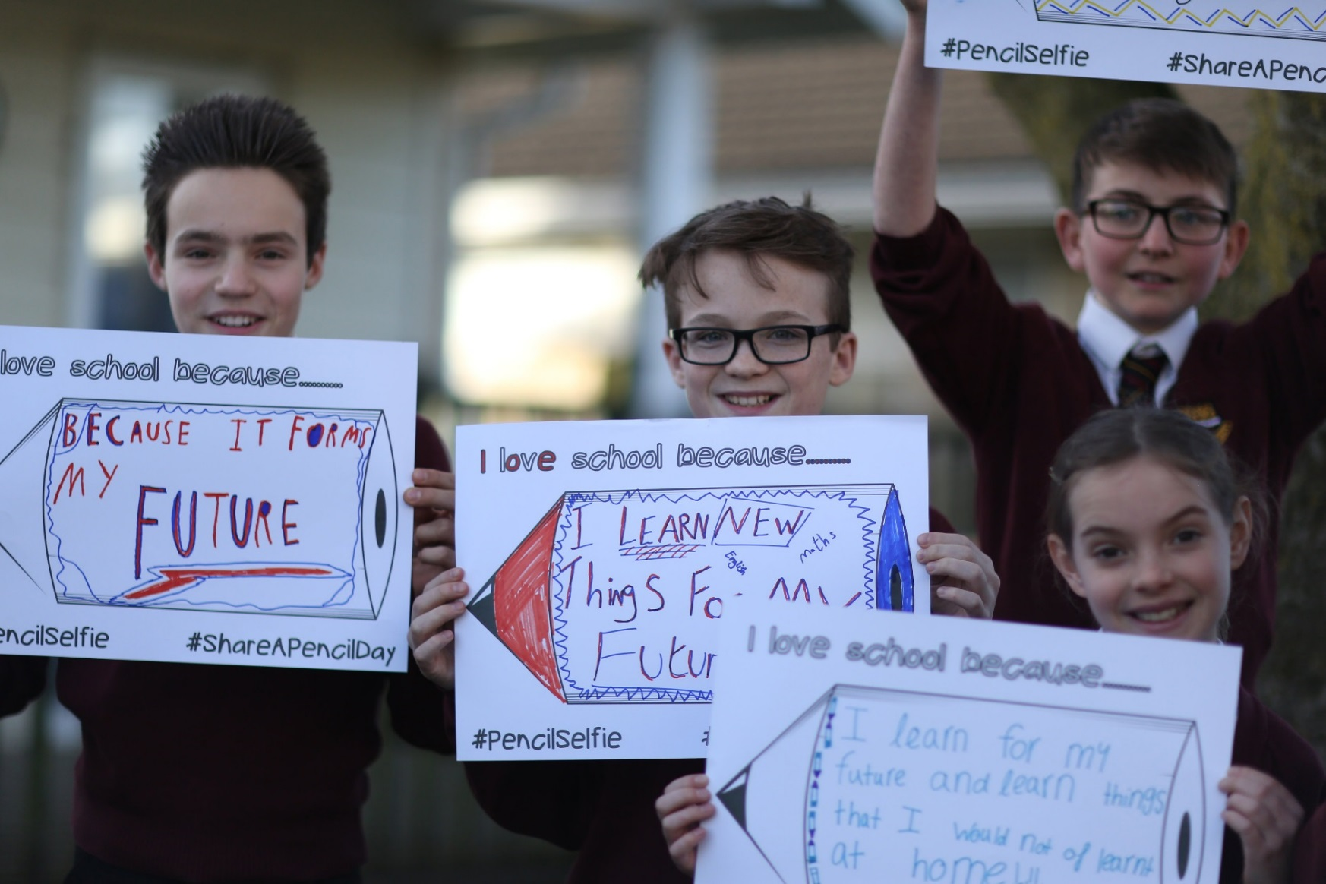
12.
Notes:
As part of that lesson or for homework you may also be asked to design your own poster “I love school because……” so we can think about what it is we like most about coming to school.
NEXT SLIDE

Slide 13
Notes:
Enjoy your day, well done for taking part and remember. Going to school makes us the lucky ones.

